Slide 1
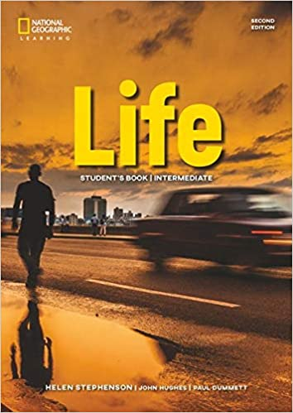
INTRODUCTION
COURSE BOOK
Life Intermediate Student’s Book, 2nd Edition.
National Geographic Learning, Cengage Learning.
(Unit 1- 4)

Slide 2
Điểm quá trình | 50%
Điểm làm bài tập online | 20%
Điểm hoạt động nói tại lớp (GVNN) | 10%
Điểm bài kiểm tra kỹ năng viết tại lớp (GVVN) (dạng tự luận) | 10%
Điểm bài kiểm tra kỹ năng nói tại lớp (GVVN) | 10%
Điểm cuối kì (thi tập trung các kỹ năng Nghe và kỹ năng Đọc dạng trắc nghiệm) | 50%
Tổng điểm | 100%

Slide 3
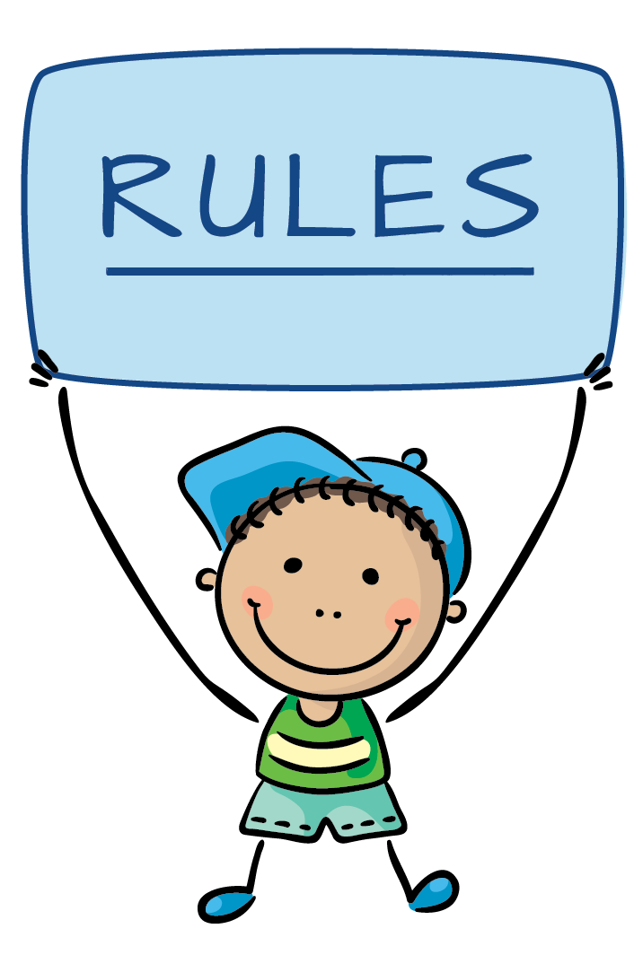
Be on time
Ask question
Practice more
Do homework

Slide 4
UNIT 1: CULTURE AND INDENTITY
Ms. Duong Tran Thuy Trinh

Slide 5
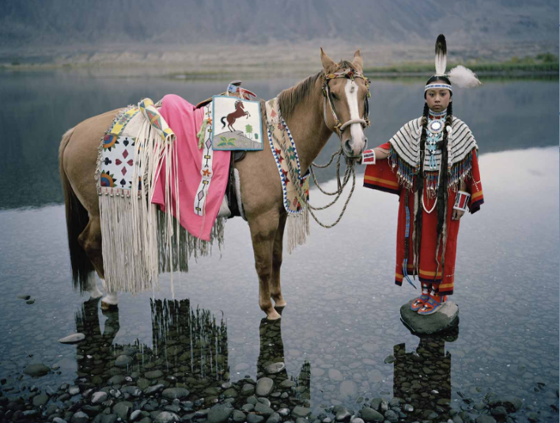
Where’s the girl from?
What’s she wearing? Traditional clothes or everyday clothes?
The photo shows two things that are important in Native American culture. What do you think they are?

Slide 6

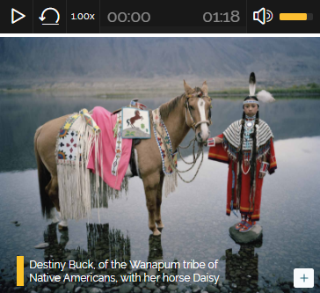
Listen and check
Where’s the girl from?
What’s she wearing? Traditional clothes or everyday clothes?
The photo shows two things that are important in Native American culture. What do you think they are?

Slide 7
Listen again and complete the sentences
People from all culture need a sense of ________________
Many native American children learn to ride _______________
Wearing the colours of our favourite team say ‘We _______________

Slide 8
DISCUSSION
Do you belong to any of these groups?
Cultural societies
Educational classes
Family groups
Hobby groups
Online communities
Sport clubs

Slide 9
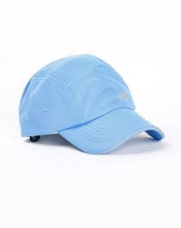
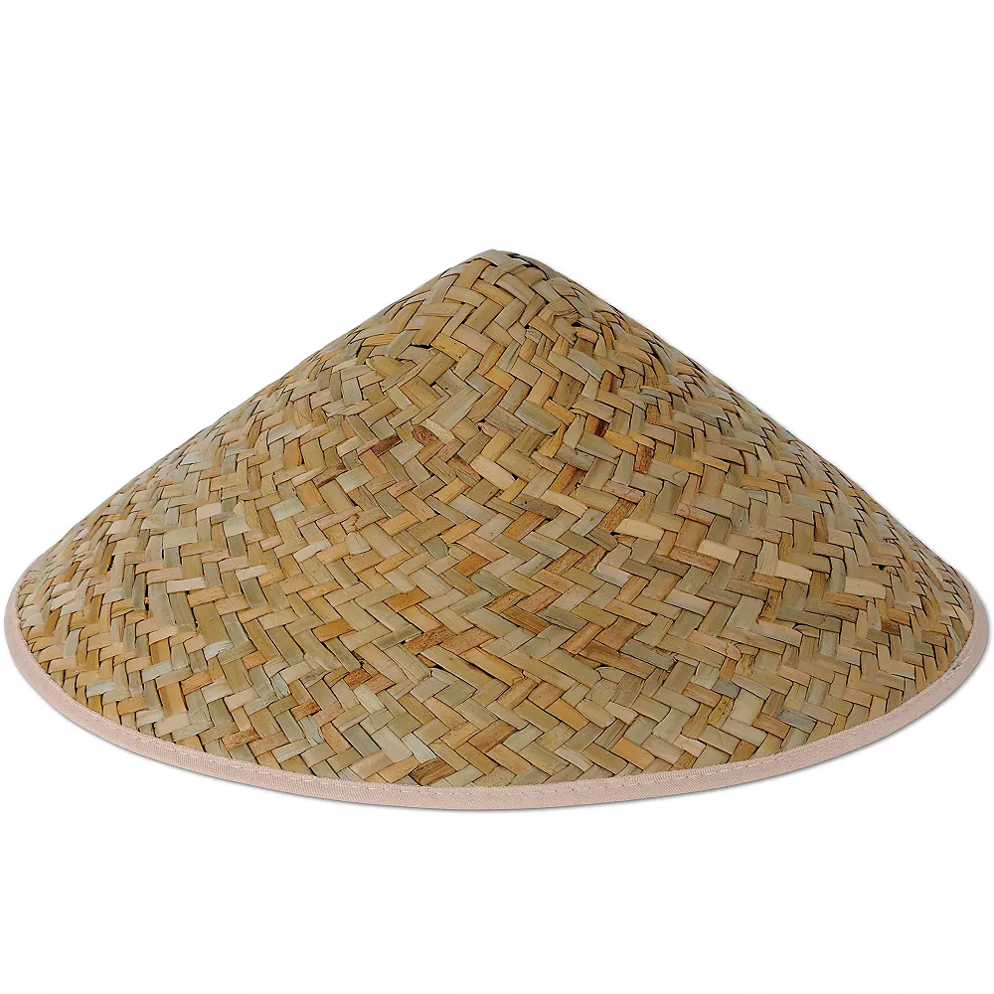

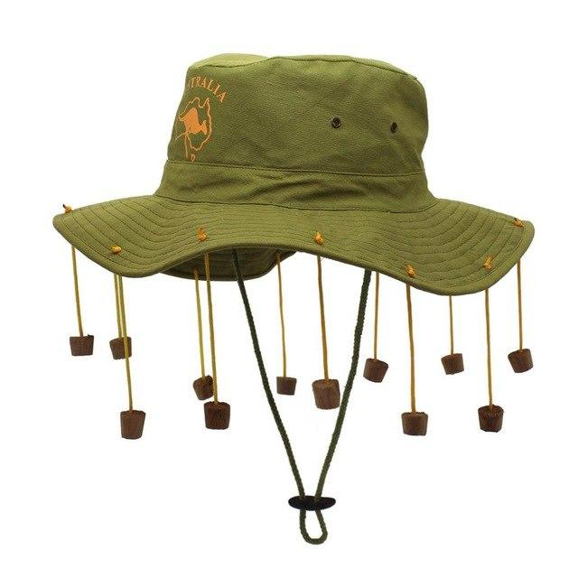
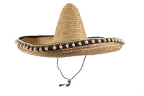
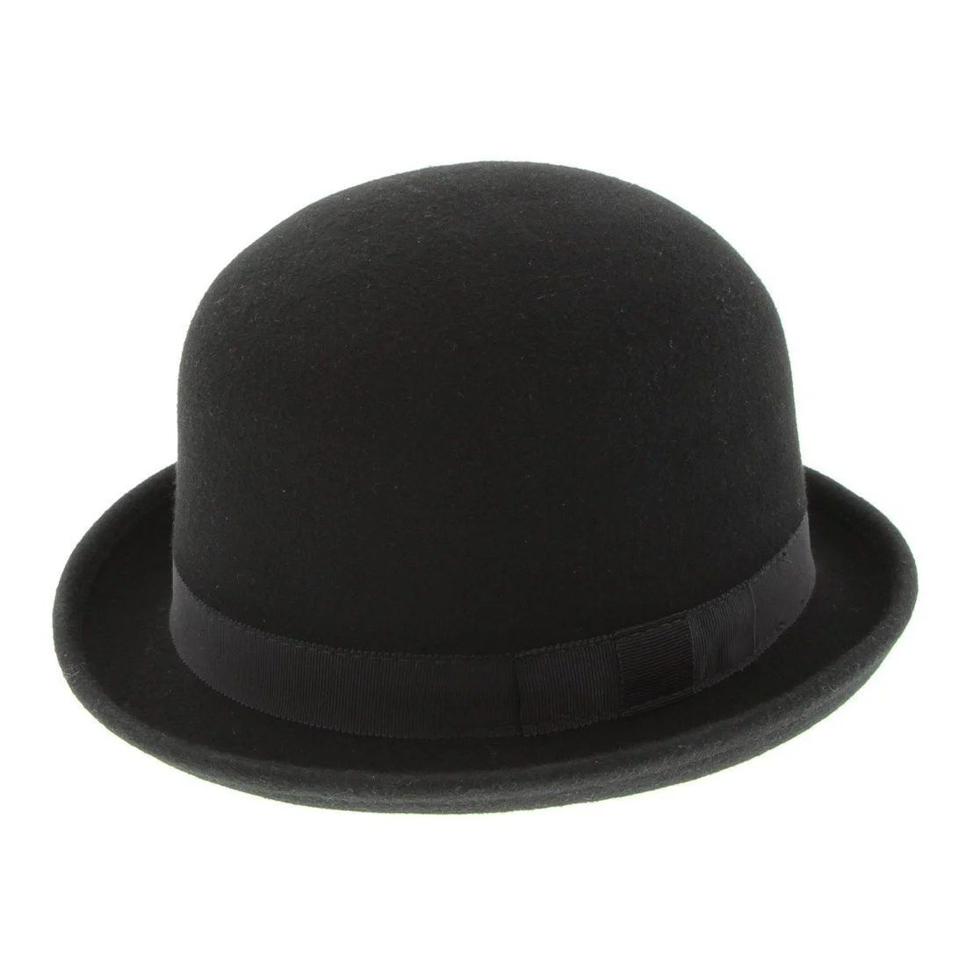

1A. HOW WE SEE OTHER CULTURES
AUSTRALIA
UNITED STATES
ENGLAND
MEXICO
VIETNAM

Slide 10
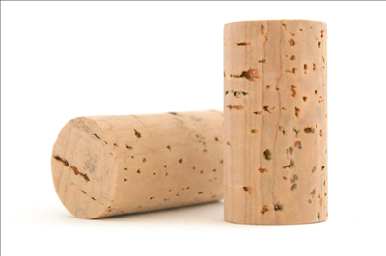
TEACHING VOCABULARY
cork /kɔːk/:
identify:
psychologist:
analyse:
prediction:
a light material obtained from the bark (= outer layer) of a tree
to recognize someone or something and say or prove who or what that person or thing is
e.g: Even the smallest baby can identify its mother by her voice.
someone who studies the human mind and human emotions and behaviour, and how different situations have an effect on people:
to study or examine something in detail, in order to discover more about it
a statement about what you think will happen in the future

Slide 11
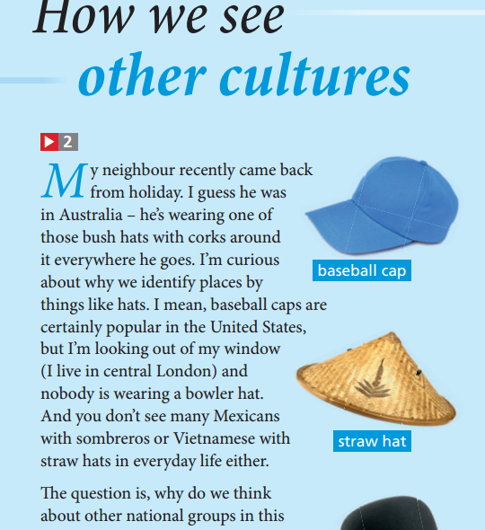
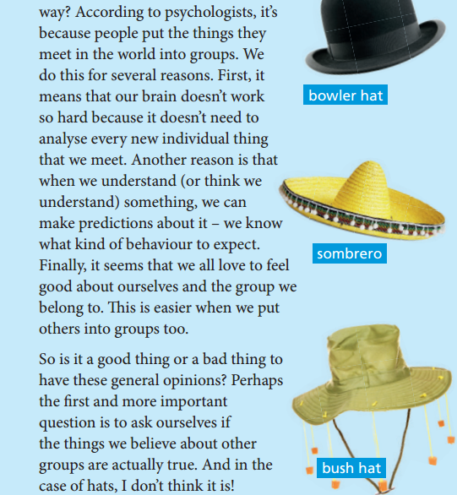

Slide 12
DISCUSSION
How do films, news report, and TV shows influence our opinions of other cultural groups.

Slide 13
Choose the correct verb.
analyse
feel
make
put
wear
When I learn new words, I always __________in groups (nouns, adjectives, verbs, etc.)
When I have to take a decision, I __________ very carefully first.
We should do something everyday that makes us __________ good about ourselves.
These days, not many people __________ hats in everyday life.
The weather is so strange at the moment. It’s hard to __________ a prediction about the weekend.
The optician says I have to __________ glasses all the time now.
I hope the teacher __________ my friends and I into the same class.
When I __________ sentences, I understand them better.
I always __________ nervous when speaking in front of a new class.
In the first few days of a course, I always __________ an effort.
Which form are they in: present simple or present continuous?

Slide 14
Look at these sentences, are they correct or incorrect?
I’m having blue eyes.
I take the train to work most days.
Are you reading anything interesting at the moment?
School children in my country aren’t wearing a uniform.
Sorry, I can’t talk now. I drive.
Are you believing this news story?
Do you know my friend Alison?
We’re preferring Edinburgh to London.
Jim doesn’t understand Italian.
Sandra’s ideas are seeming crazy to me.

Slide 15
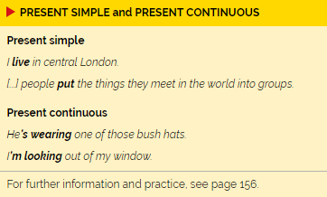
Which verb form do we use for these things:
Things are permanent or generally true.
Things which are temporary or in progress at the time of speaking.

Slide 16
Exercise: Complete the sentences with correct tense.
1a. I ___________ for a large cultural organization.
1b. I ___________ extra hours. It’s the busy season at work.
2a. We ___________ with my parents until our flat is ready.
2b. We ___________ just outside the city.
3a. The kids ___________ naughty today, sorry!
3b. The kids ___________ usually very good.
4a. She ___________ an exam every week.
4b. She ___________ some problems with her school work.

Slide 17
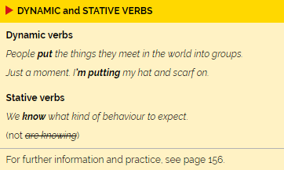
GRAMMAR
Dynamic verbs are used
in both continuous and
simple form.
Stative verbs are not
normally used in
Continuous form.

Slide 18
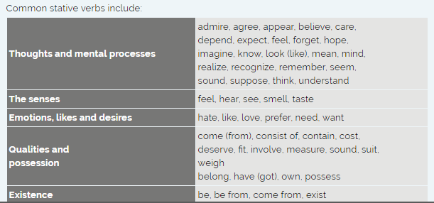

Slide 19
Word focus: love
When could we use each expression below:
I’d love to. Thanks!
I love walking in the rain.
Lots of love. Jenna.
We love the summer.
Please give Osca our love.
The story of two strangers who fall in love.
They are very much in love.
I’m loving it.

Slide 20
Choose the correct option to complete the expression with love.
1. Love at first sight means you like someone
Before you meet them.
The first time they see you.
The first time you see them.
2. If something is a labour of love, you do it.
For someone you love a lot.
Because you really want to, not because you get paid.
With people you really like.
3. A love-hate relationship is one where
One person loves and the other person hates.
You enjoy feeling negative about something.
You feel both emotion at the same time.
4. You can write Lots of love at the end of
A business letter.
An informal letter.
A job application.

Slide 21
Choose the correct option to complete the expression with love.
5. The expression ‘ We’re loving our new house.
Has no meaning at all.
Is formal English.
Is OK in informal English.
6. Which response is correct? A. Do you want to meet before tomorrow?
I love to,
I’d love to.
I’m loving to
7. Pizza is our favourite food.
I enjoy Pizza.
I like Pizza.
I love Pizza.
8. Complete the sentence from an email. Say hi to your parents and
Give them my love.
Pass them my love.
Tell them my love.

Slide 22
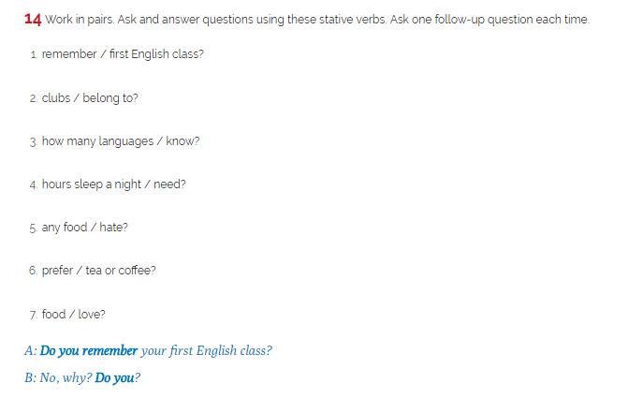
DISCUSSION

Slide 23
1c: Culture and colour
How do you think the people described feel? Choose from these adjectives.
He’s feeling a bit blue today.
He just saw red.
He’s in black mood today.
angry
cheerful
happy
lucky
positive
sad

Slide 24
Choose the correct option to complete the sentences
What are two things that make you____
When did you last have some good____
Can you tell me if you are____
What achievement are you____ of
Do you think____ is a good thing?
Do you know who the most____ person in the world is?
a. happy b. happiness
a. luck b. lucky
a. brave b. bravery
a. pride b. proud
a. anger b. angry
a. power b. powerful

Slide 25
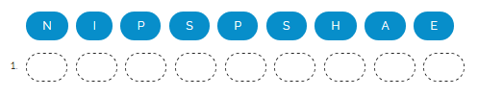
Put the letters in correct order to make nouns describing feelings. What the adjective for each noun. Talk about a time when you have this feeling and why.

Slide 26
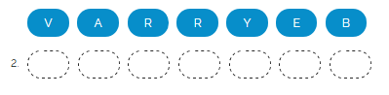
Put the letters in correct order to make nouns describing feelings. What the adjective for each noun. Talk about a time when you have this feeling and why.

Slide 27
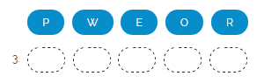
Put the letters in correct order to make nouns describing feelings. What the adjective for each noun. Talk about a time when you have this feeling and why.

Slide 28
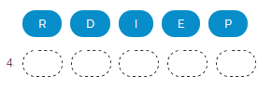
Put the letters in correct order to make nouns describing feelings. What the adjective for each noun. Talk about a time when you have this feeling and why.

Slide 29
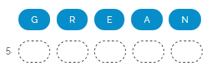
Put the letters in correct order to make nouns describing feelings. What the adjective for each noun. Talk about a time when you have this feeling and why.

Slide 30
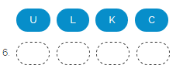
Put the letters in correct order to make nouns describing feelings. What the adjective for each noun. Talk about a time when you have this feeling and why.

Slide 31
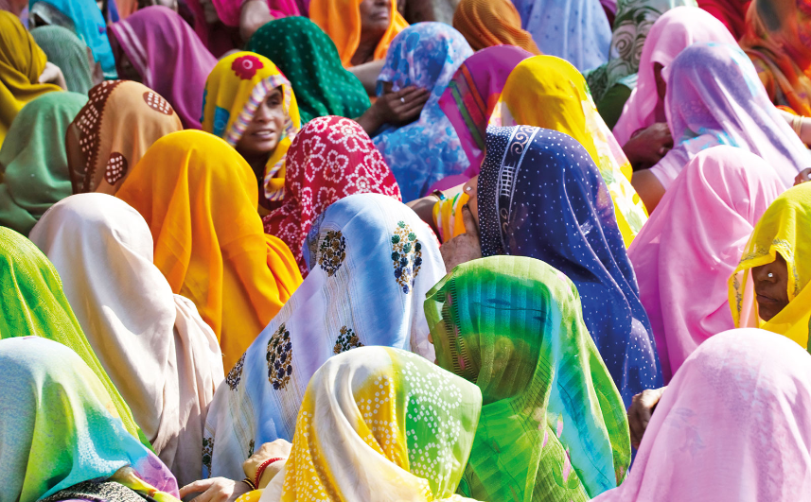
Colour
and
their meaning
1. Where are the women going?
To a party
To a wedding
2. Does red mean different things in Eastern and Western cultures?
Yes
No
3. Where does ‘yellow’ mean ‘Knowledge’?
China
India
4. Which colour means ‘Happiness’ in Japan?
Orange
Pink
5. Do Mexicans wear blues at funerals?
Yes
No
6. Who uses ‘green’ as their symbol?
environmentalists
The women’s movement

Slide 32
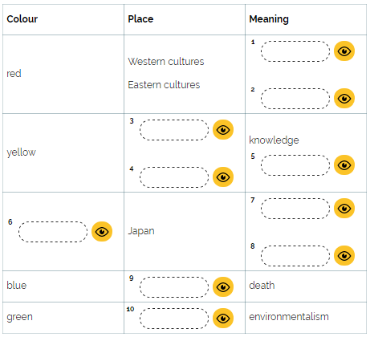
Listen again and complete the table

Slide 33
What do these colours mean in your country? What is your favourite colour?
red
YELLOW
ORANGE
BLUE
GREEN

Slide 34
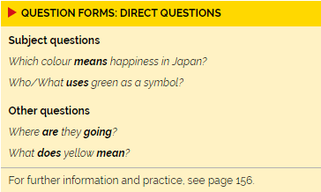
GRAMMAR: QUESTION FORMS
Has the same Subject-verb order as affirmative sentences

Slide 35
Which questions are object questions? Which are subject questions?
1. Where are the women going?
To a party
To a wedding
2. Does red mean different things in Eastern and Western cultures?
Yes
No
3. Where does ‘yellow’ mean ‘Knowledge’?
China
India
4. Which colour means ‘Happiness’ in Japan?
Orange
Pink
5. Do Mexicans wear blues at funerals?
Yes
No
6. Who uses ‘green’ as their symbol?
environmentalists
The women’s movement

Slide 36
Write questions for these answers. Begin with words in brackets.
Mexicans wear blue at funerals. (who)
Yellow means happiness in Egypt. (which colour)
Some people wear purple on International Women’s day. (what colour)
Picasso painted a white dove as symbol of peace. (who)
Red means anger in many cultures. (what)
The United States president lives in the White House. (who)

Slide 37
Pronunciation: questions
Listen to the questions. Does the speaker voice rise at the end of the questions? Or does it rises, then falls.

Slide 38
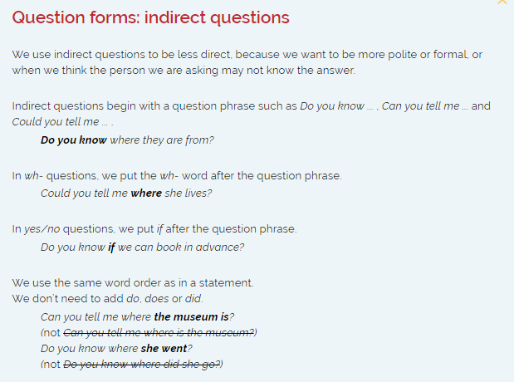

Slide 39
Write indirect questions for these direct questions. Begin with words in brackets
How many hours a week do you study English? (Can you tell me)
Why are you doing this course? (Can you tell me)
When does the course finish? (Do you know)
How many languages does the teacher speak? (Do you know)
Which other courses are you doing? (Can you tell me)
How many students are there in this class? (Do you know)

Slide 40

EXTRA ACTIVITY
Put the words in correct order to make questions:

Slide 41
EXTRA ACTIVITY
Put the words in correct order to make questions:

Slide 42
EXTRA ACTIVITY
Put the words in correct order to make questions:

Slide 43
EXTRA ACTIVITY
Put the words in correct order to make questions:

Slide 44
EXTRA ACTIVITY
Put the words in correct order to make questions:

Slide 45
DISCUSSION
1. Can you tell me how many hours a week you study English?
2. Can you tell me why you are doing this course?
3. Do you know when the course finishes?
4. Do you know how many languages the teacher speaks?
5. Can you tell me which other courses you are doing?
6. Do you know how many students there are in this class?

Slide 46
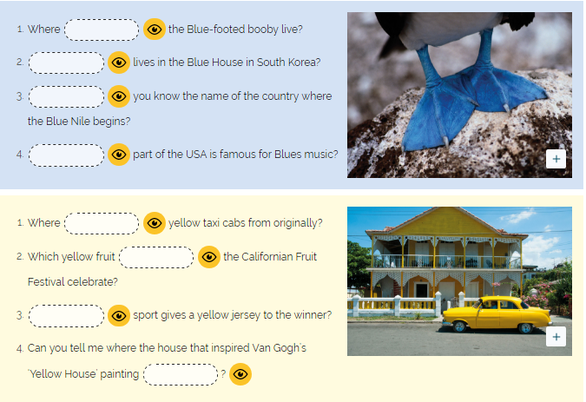
Complete the questions with verbs or question words

